Slide 1

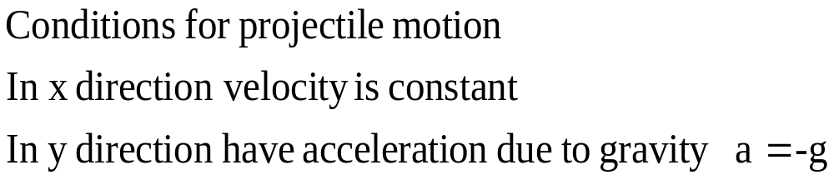
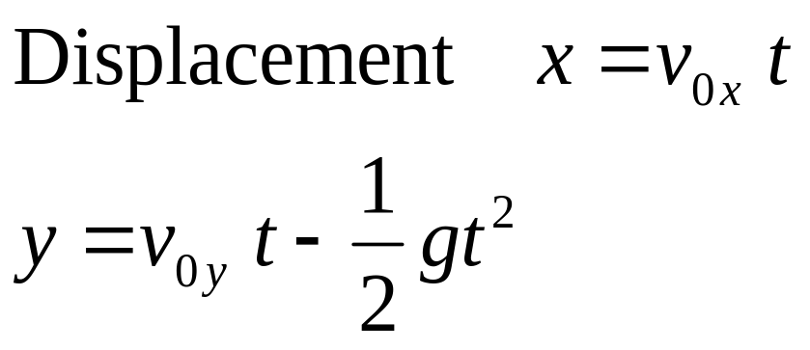
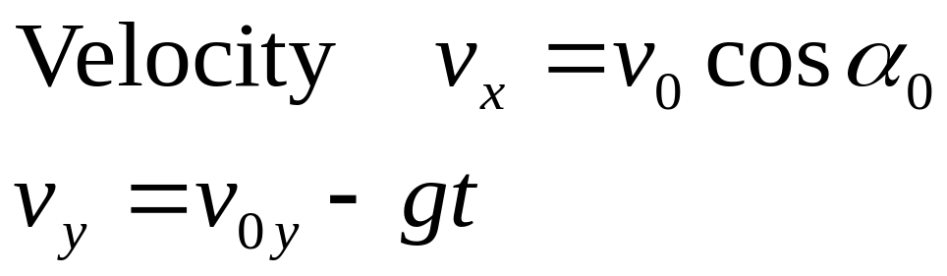
Projectile motion
Physics 131
Lecture 5
Young and Freedman, University Physics 3.3
Notes:
Demo- frog physics
Today we are going to continue with motion in a plane

Slide 2

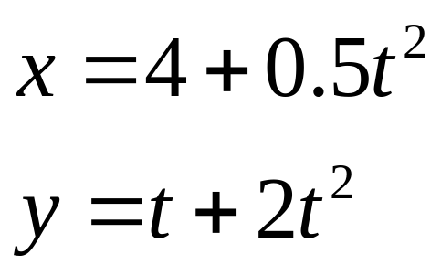
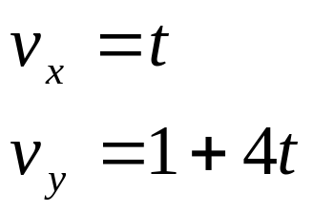
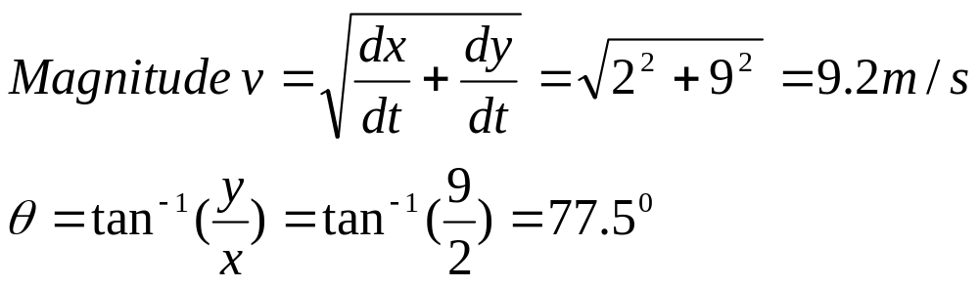
Review:
A toy car has the co-ordinates in a 2D plane given by the following equations
Find the magnitude and direction of velocity at t = 2 sec.
Notes:
Last lecture we combined what we’ve learnt about motion in a straight line with what we know about vectors to help us understand and compute values for motion in a plane, or motion in 2-D or even 3-D. We learnt about :
Position vectors
Vector definitions of velocity
Vector definitions of acceleration
Solving problems with the above
……@
Heres a picture of what I did on the weekend..

Slide 3
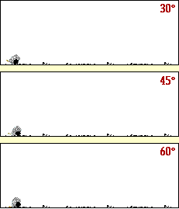
What is a Projectile?
Projectile – any body that is given an initial velocity which then follows a path influenced by gravity.
It may be given different magnitudes of initial velocity v₀ or different launch angle α
Trajectory - path followed by a projectile
Notes:
Demo----- Frog Physics…..
Projectile – any body that is given an initial velocity which then follows a path determined entirely by the effects of gravitational acceleration and air resistance
Trajectory - path followed by a projectile
We’ll use an idealised model representing the projectile as a single particle with constant acceleration due to gravity.

Slide 4
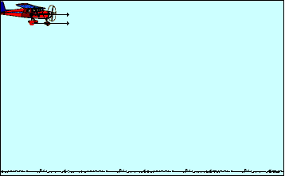

Projectile motion is made of a horizontal component v_{x} and a vertical component v_{y}
When in the air:
In vertical direction a = -9.8m/s²
In horizontal direction v = constant.
Notes:
If we ignore air resistance.. Although this can be allowed for….
Can divide motion into x and y compsonents…

Slide 5
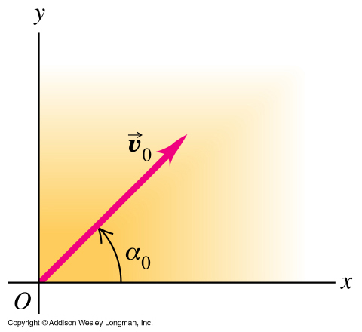
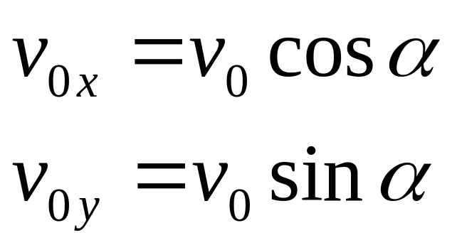
Need to separate x and y directions for initial velocity
Trajectory moving in a vertical plane… so 2D motion
Make
x direction – horizontal direction
y direction – vertical direction
α is the angle of elevation
v₀ = initial velocity
Notes:
When a cannon is fired- it is ito 3 dimensional space- however its trajectory can be reduced to a 2 dimensional plane.
The initial velocity is v0 and the initial angle is alpha- this angle will of course change…
If the plane is situated in the vertical position under the projectile. Can reduce to 2D x-y plane. X in the horizontal direction. Y in the vertical.
We need to calculate the x velocity- which is constant. Also the y velocity which has an acceleration of -9.8 m/s2.
Accn is constant so we can use those equations of motion for constant accn we derived earlier.

Slide 6
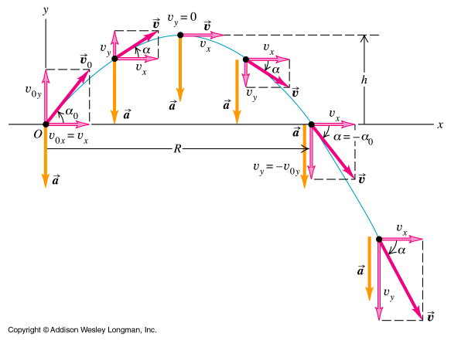
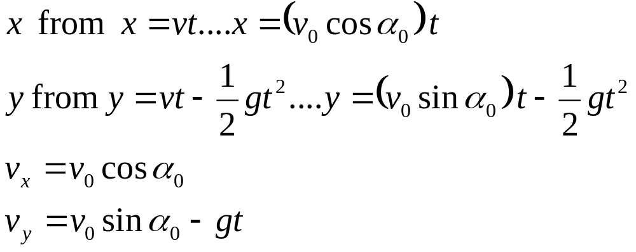
Notes:
Equations for projectile motion
For displacement in both the y and x direciton
And velocity in the x and y direction
The x velocity is the same at all points.
The y is the initial velocity in the y direction v=v0+at
Initially in the + y direction. Then zero. Then –y direction.

Slide 7
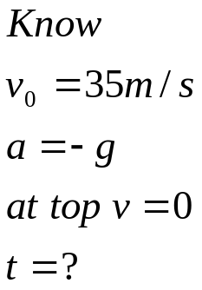
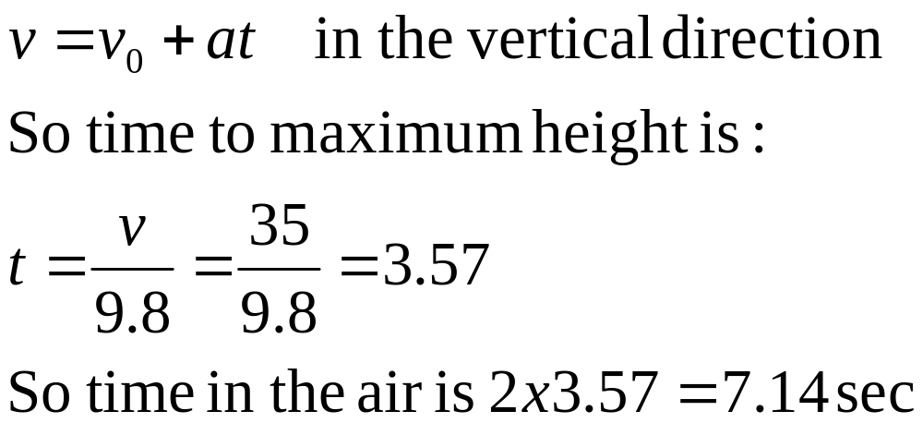
Review: Example: Projectile
A ball is launched vertically upwards at 35 m/s.
How long is it in the air for?

Slide 8

Javier Sotomayer world record for high jumping
2.45 m in Salamanca 93

Slide 9
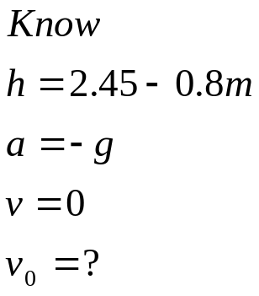
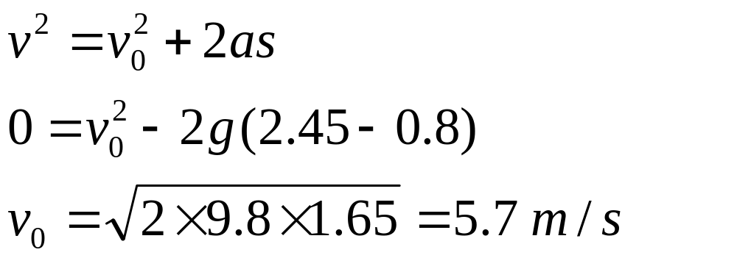
Calculate initial velocity
What initial vertical velocity does Javier need if his initial center of mass is 0.8 above the ground. And to clear the bar at 2.45 m his center of mass needs to equal the height of the bar.

Slide 10

Long Jump
Mike Powell at the World Championships in Tokyo in 1991 leapt a distance of 8.95 m

Slide 11

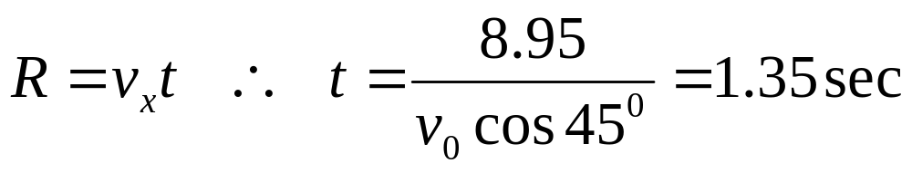
Calculate the time in the air given that Mike needed an initial velocity of 9.365 m/s at an angle of 45⁰

Slide 12

So...If a ball rolls off a table…at different speeds does this change the velocity at which it hits the floor?
v_{y}² = -2(9.8)h (from v² = v₀² +2ax)
V_{fy} Final velocity in the vertical direction is dependent only on height and independent on v_{x}
V_{fx} Final velocity in the horizontal direction is the same as initial.
Final speed would depend on v_{0x} since that will be horizontal component.
v_{x}

Slide 13

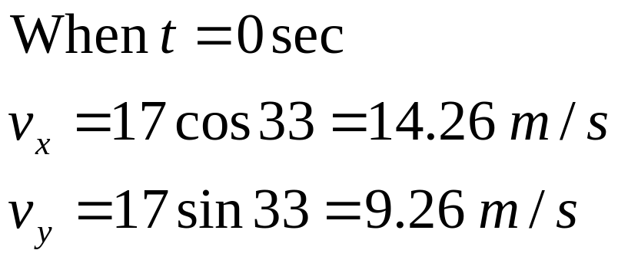
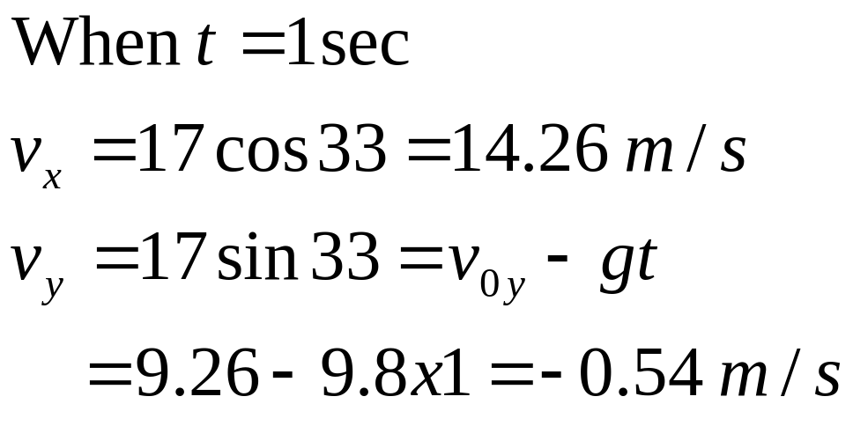
Cricket Ball hit for six
A cricket ball is hit at 17 m/s at an angle of 33⁰.
What is the components of its velocity at t= 0 and 1?
33⁰

Slide 14
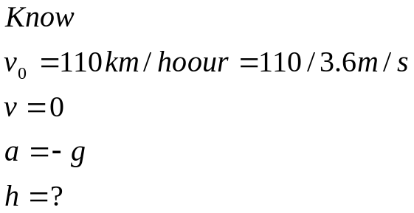

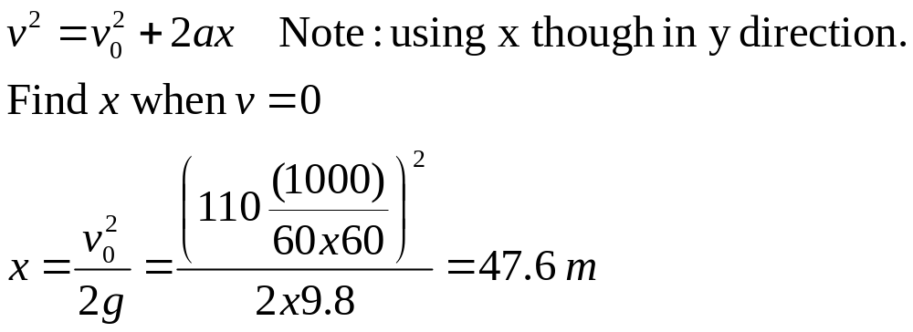
Maximum height of tennis ball
Martina Hingis says that she can hit a tennis ball at 110 km/hour. If he hits it straight up, how high does it go?

Slide 15

Example- Cannon
A cannon fires a ball at v₀=500 m/s.
At what angle should it be projected to Maximise Range R?
Notes:
Lets look at a cannon…
What angle gives…. maximum range…

Slide 16
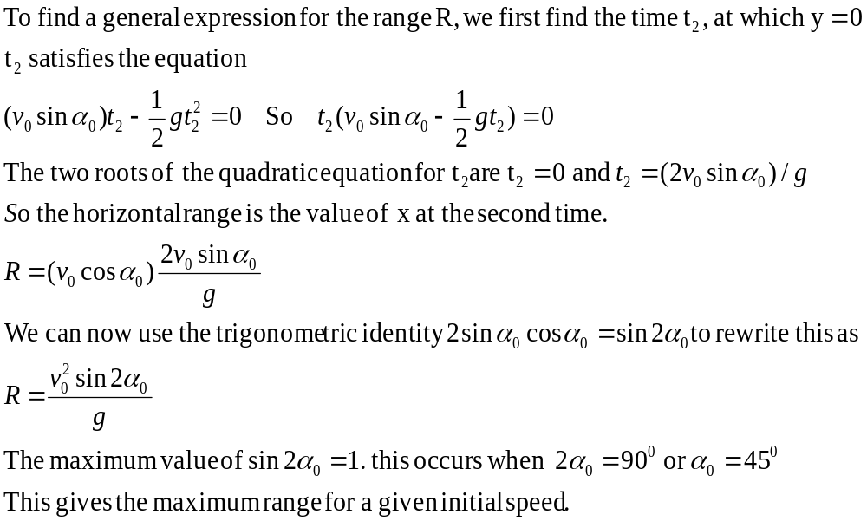
(3.11) Cannon (cont)

Slide 17
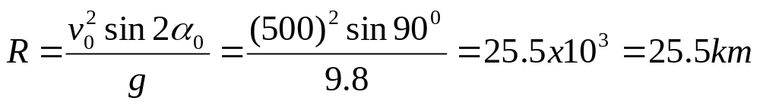
Cannon (cont)
Using the maximum range R equation and initial velocity 500 m/s, find the Range of the cannon.
Notes:
Maximum range at the angle of 45 degrees.

Slide 18
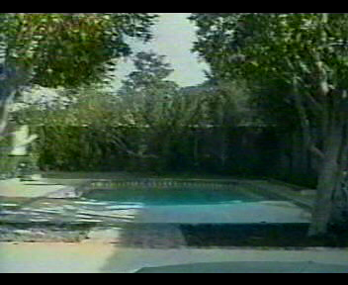

Slide 19
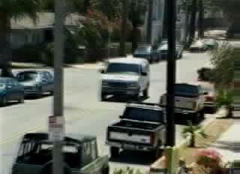

Slide 20

Motorcycle jump...

Slide 21
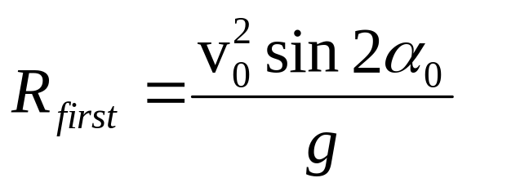
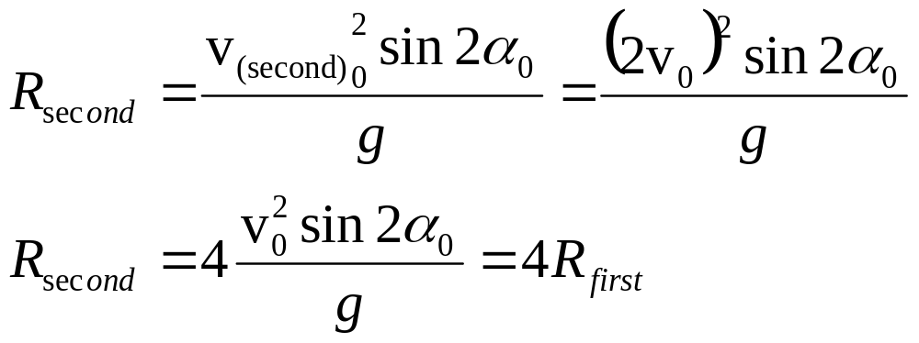
Motorcycle jump
From Range equation can see that range is proportional to the square of the initial velocity
If have twice the initial velocity on the second jump
Then range is four times larger.
Notes:
Maximum range at the angle of 45 degrees.

Slide 22
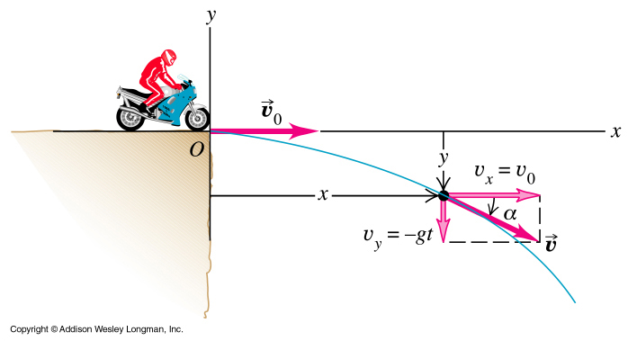
Example 3.6 A motorcycle projected horizontally from the edge of a cliff at 9 m/s.
Notes:
Lets have a look at a motorbike riding off the edge of a cliff….

Slide 23
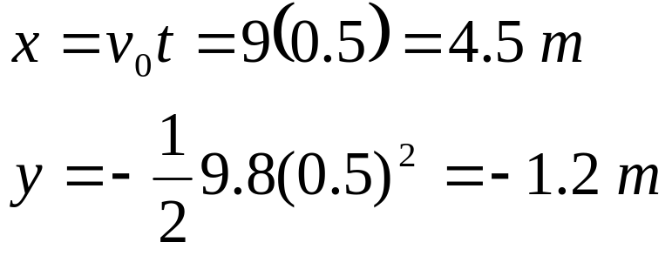
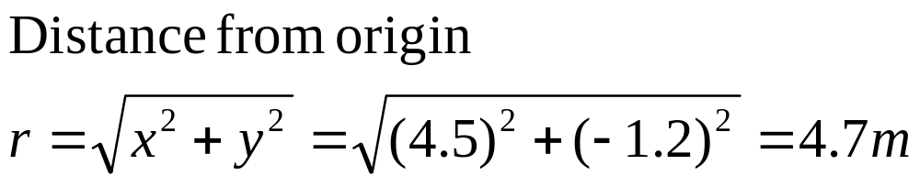
Example 3-7 A motorcycle projected horizontally
a) Find the motorcycle’s position, distance from the edge of the cliff, and velocity after 0.5 sec.
Find the motorcycle’s position,
b) Calculate the distance from the edge of the cliff,

Slide 24
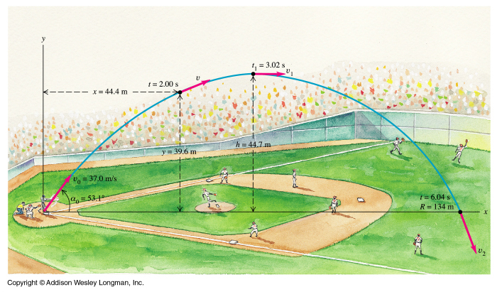
Example 3-8 Baseball
A batter hits a baseball so that it leaves the bat with an initial speed v₀=37 m/s at an angle α = 53.1⁰.
Notes:
Heres an example of projectile motion in baseball
Mpeg heres a spectacular catch….

Slide 25
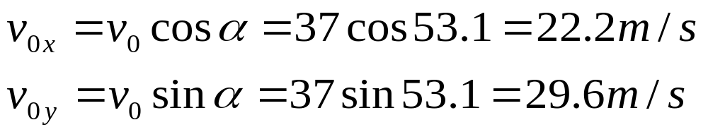
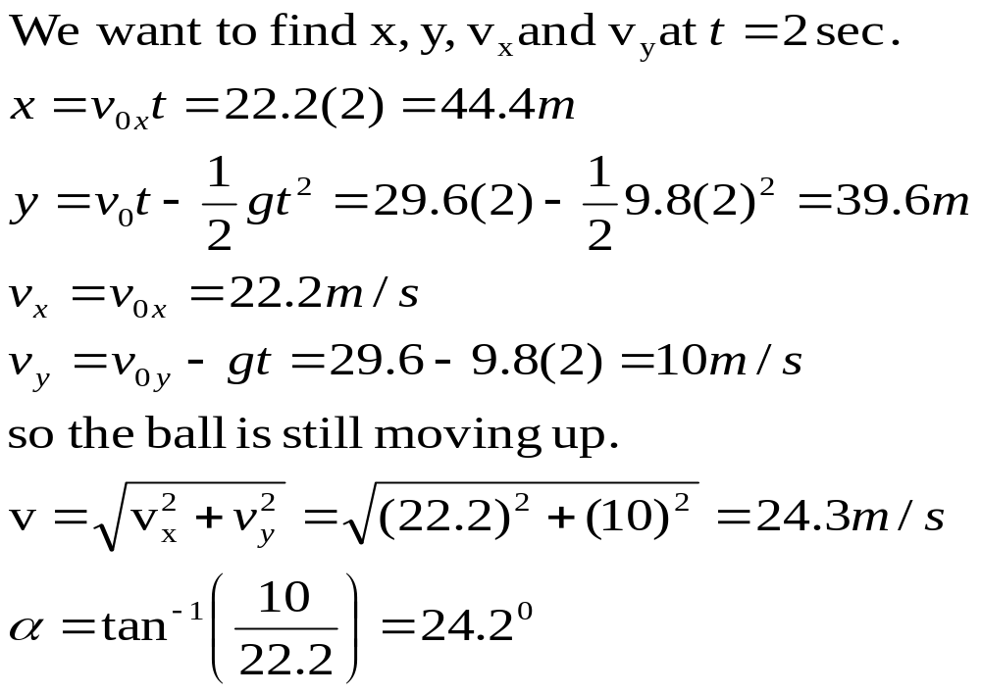
Example 3.8 Baseball
37 m/s
53.1⁰
a) Find the position of the ball, and the magnitude and direction of its velocity at t = 2 sec.
Notes:
Find the vertical and horizontal velocities….
Then vertical and horizontal velocities after 2 sec….
Then magnitude and direction at 2 sec..

Slide 26
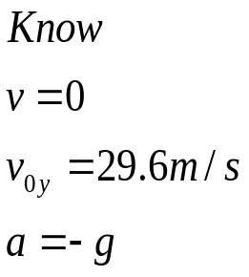
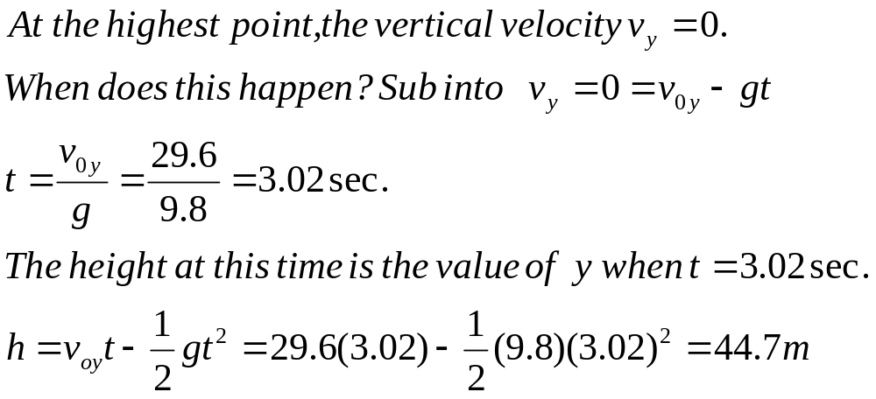
Example 3.8 Baseball (cont)
b) find the time for the ball to reach its highest point and its height at this point.

Slide 27
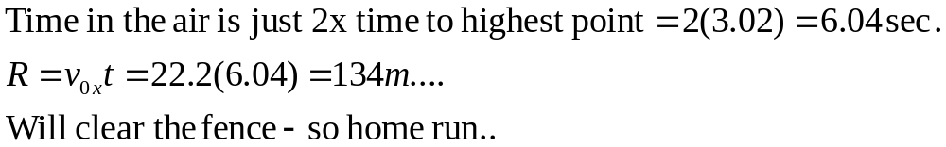
Example 3.8 Baseball
c) Find the horizontal range R

Slide 28
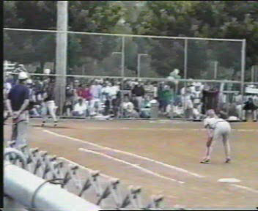

Slide 29
Example: Monkey in tree
A clever monkey escapes from the zoo.
The zoo keeper finds him in a tree, and failing to entice the monkey down…points her tranquilizer gun directly at the monkey and shoots…
The clever monkey lets go at the same time the dark leaves the gun barrel, intending to land on the ground…..
Show that the dart will always hit the monkey- regardless of the darts velocity.
Notes:
A famous physics problem….
It used to be a hunter in Africa shooting a monkey- now it’s a zoo keeper with a tranquilizer….

Slide 30
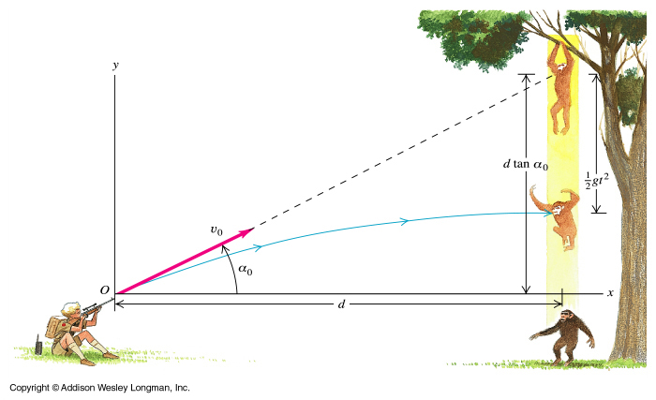
Monkey in tree (cont)

Slide 31
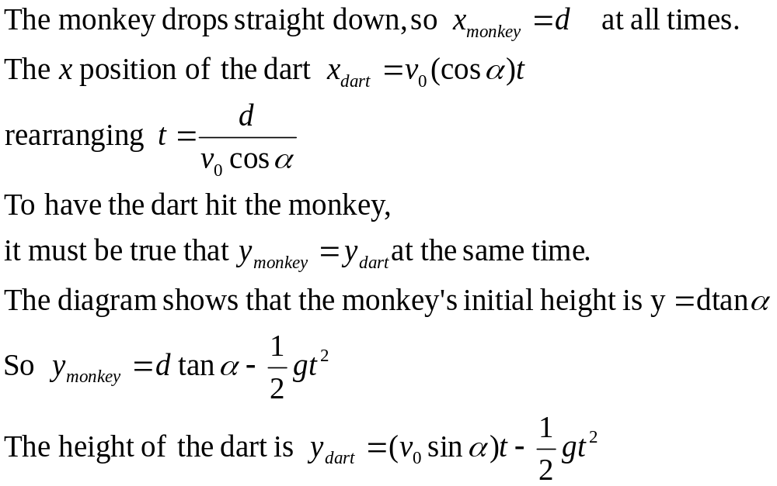
Monkey in tree (cont)
Notes:
Find time when the dart hits the monkey

Slide 32
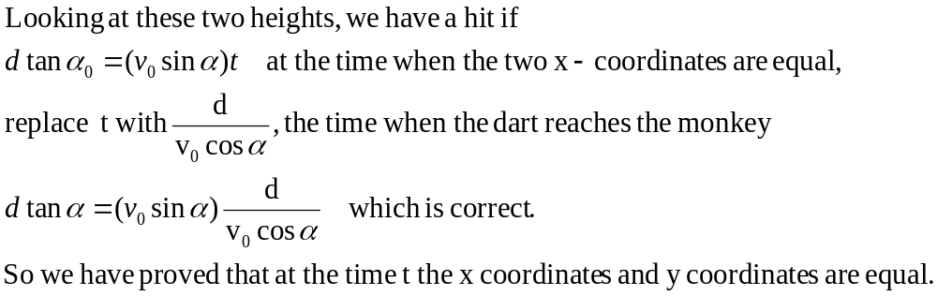
Monkey in tree (cont)
Does this depend on initial velocity?
Does it depend on gravity?
Notes:
Need to calculate the position x and y for both the dark and the monkey… when x=x and y=y for a certain time… Then the monkey is hit….

Slide 33
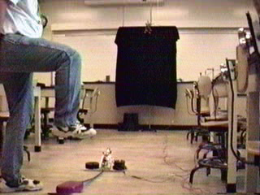

Slide 34
Lecture 5-What you need to know and where to find it
Acceleration due to gravity
Resolve v_{o} into x and y components.
Equations for projectile motion.
All found in Young and Freedman, University Physics chapter 3.3

Slide 35
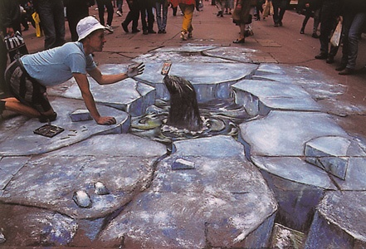
Making 3D out of 2D

